Slide 1
Methodology: Data Analysis
Troy Thomas

Slide 2
Data Sources
Primary Data
Collected by the researcher
Collected for specific purpose
Researcher has control over methodology and data quality
Requires time, resources & expertise.
Allows greater flexibility

Slide 3
Data Sources
Secondary Data
Obtained from organisations and publications.
Quick results
Data collection expertise not required
Not collected for specific purpose for which it is used.
No control over methodology and data quality
May be summarised to a great extent

Slide 4
Sampling
Why is this important?
Impacts on validity and reliability of results.
Determine generalisability of results.
Improper sampling can result in a great research idea having little or no value.
No amount of sophisticated statistical techniques can compensate for improper sampling.
Garbage in; garbage out.

Slide 5
Sampling Strategy
Determine the population
Sampling cannot proceed without determination of the population.
To whom should the results be relevant?
Sample to represent the population
Probability sampling is the best approach.
Other types of samples are less generalisable and requires greater justification for acceptance.

Slide 6
Sampling
Probability sampling
Randomness is key
Use a (pseudo) random number generator
Gold Standard: all elements of the population should be equally likely to be selected.

Slide 7
Probability Sampling Methodologies
Simple Random Sampling (Gold Standard: almost never used)
Equi-probable inclusion probabilities for every element.
Stratified Random Sampling (used most often with some variation)
Proportional representation of strata.
Offer reduction in variance compared to SRS.
Strata identification must be based on theory to avoid counter productivity in the form of variance inflation (decreased reliability)
Variations may be for pragmatic reasons and weighting should be used to make adjustments.

Slide 8
Probability Sampling Methodologies
Systematic Random Sampling (used in multi-stage designs)
Population elements are arranged in some order based on some variable or set of variables e.g. Age, temporal order.
The context may determine which variable(s) is(are) appropriate.
Reduces variance if done properly
Cluster Sampling (used often in multi-stage designs)
A stratum or set of strata are chosen at random and all elements in the chosen strata or stratum are included.
Used especially when population is inaccessible.
May lead to bias and variance inflation.

Slide 9
Sampling Design
Sampling design specifies the inclusion probability of every element of the population.
The elements of the population (or the number of elements) must be known.
When inclusion for the elements is not equi-probable, weighting should be used to make adjustments.
The weight is the inverse of the inclusion probability.

Slide 10
Sampling Design
For experiments (or quasi-experiments), this also includes the assignment of elements (or participants) to treatments.
If the assignment to treatments is randomised then we have an experiment
If the assignment to treatments is not randomised we have a quasi experiment.

Slide 11
Comparing Population Means
The shape of the distribution of the sample mean is articulated in the Central Limit Theorem (CLT)
The key is to have a large enough sample size (say n >25) for the distribution to be normal
Note this sample size does not guarantee that there is enough power neither does it automatically allow for adequate control of errors.
The sample size required for normality is not the sample size estimate for your research.

Slide 12
Distribution of Means
When the population variance is unknown (usually the case), the Student’s t-distribution applies.
The t-distributions have heavier tails than the normal distribution.
The t-distribution approaches the z distribution as df approaches infinity.

Slide 13
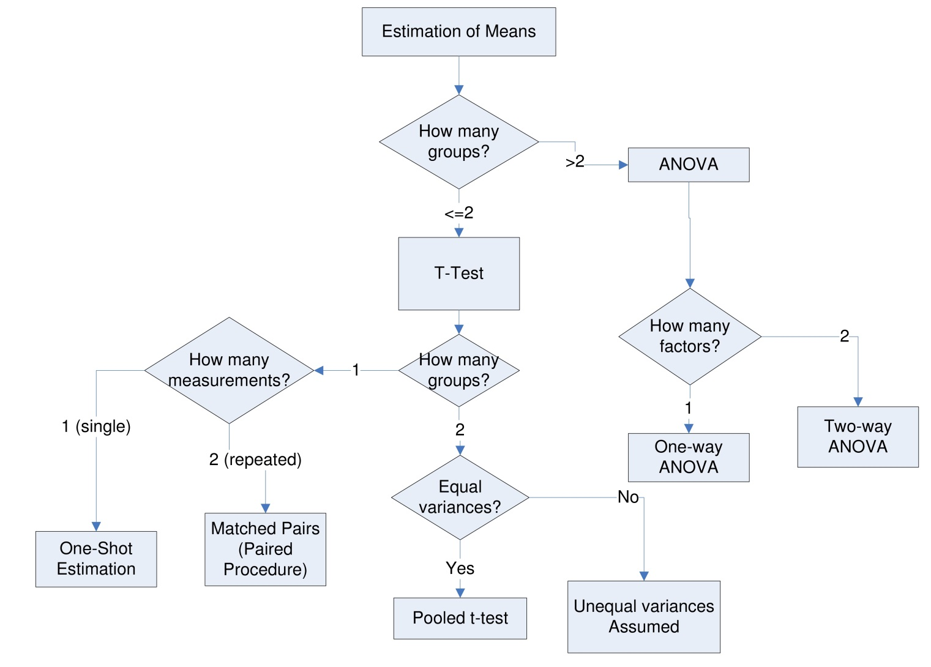
Group Comparisons: A family of Techniques

Slide 14
Evaluation of Methodologies or Techniques
Data Recovery
This focuses generally on confirming what is known about the data. Methods/techniques that provide closer approximations to reality are better.
The closeness of the approximations can be judged based on methods for group comparisons or on probability.

Slide 15
Data Recovery
Monte Carlo Experiments
Random generation of data with known constraints.
Data recovery is judged based on how well a technique “recovers” what is known to be in the data.
These experiments may not mirror real-world experience. However, the results are immediately generalisable.

Slide 16
Data Recovery
Simple Results Confirmation
Similar to Monte-Carlo experiments but real data are used.
Results are similar to real-world experience
The constraints evaluated are determined by the data and are out of the control of the researcher. This limits generalisability. Many repetitions are required for generalisability.

